Slide 1


Week 2

Slide 2
Lists
Bullet List
<ul>
<li>Sips Tea</li>
<li>I love boba tea</li>
</ul>
Numbered Lists
<ol>
<li>Sips Tea</li>
<li>I love boba tea</li>
</ol>

Slide 3
Span and Div
span is an inline element while div is a block element
Used to group things together, really helpful for when you need to style a group of things
Adding some structure to our web page

Slide 4
Classes and Ids
Classes: can be used so that different elements can have the same style
Id: an id must be unique, therefore it is used to differentiate certain elements/groups of elements. (Really useful when you start to use js)

Slide 5
CSS
<link href = “main.css” rel = "stylesheet” type= “text/css”/>

Slide 6
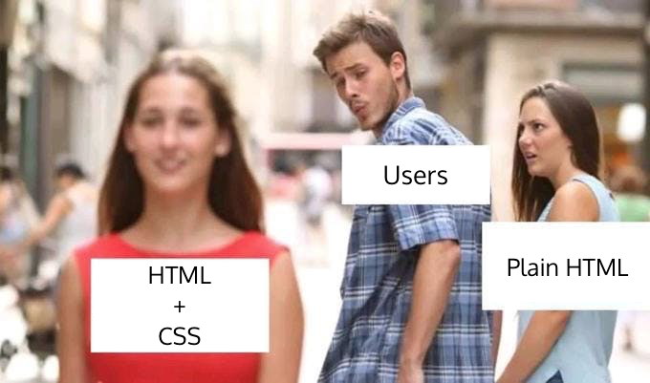

Slide 7
Background
Color
background-color: lightblue;
Image
background-image: url(ripHarambe.jpg);
background-repeat: no-repeat;
background-size: 100% 100%;

Slide 8
Styling Fonts
Font size
font-size: 12pt; (can also do px)
Font weight
font-weight: 100;
font-weight: 900;
Font color
color: red;
Font Family
font-family: Helvetica Neue;

Slide 9
Links
link (normal, unvisited link)
a:link{color:yellow;}
visited
a:visited{color:green;}
active (when being clicked)
a:active{color:blue;
hover
a:hover{color: red;}

Slide 10
Types of Measurement
in (inches)
px (pixels)
cm (centimeter)
ex (size of a lower case x)
em ( size of a capital M)

Slide 11
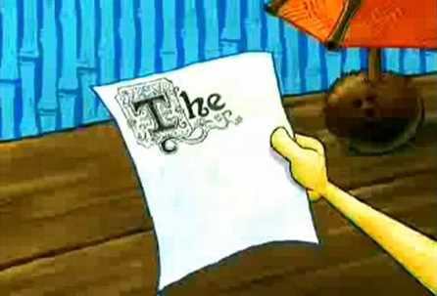

Design

Slide 12
Want a Good Color Scheme?
https://coolors.co/

Slide 13
Another Helpful Site on Colors
Adobe Kuler

Slide 14
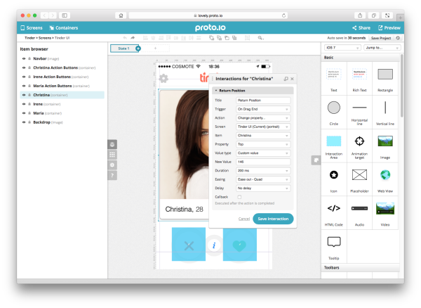
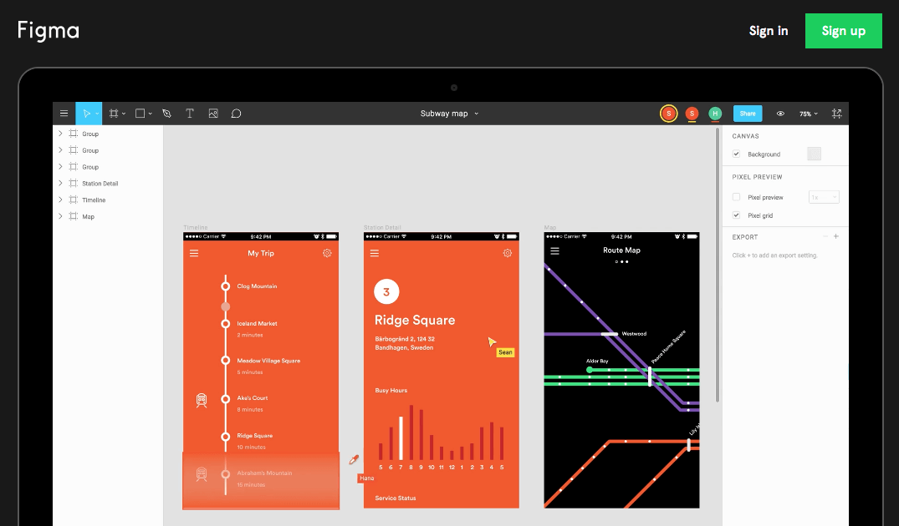
Prototyping your web app
Figma
Proto.io

Slide 15
Rules To Follow:
Simple is Beautiful
User Friendly is Key
Utilize White Space
Fonts Matter
Be Consistent
Have a Good Color Scheme
Make Sure it is Not Cluttered

Slide 16

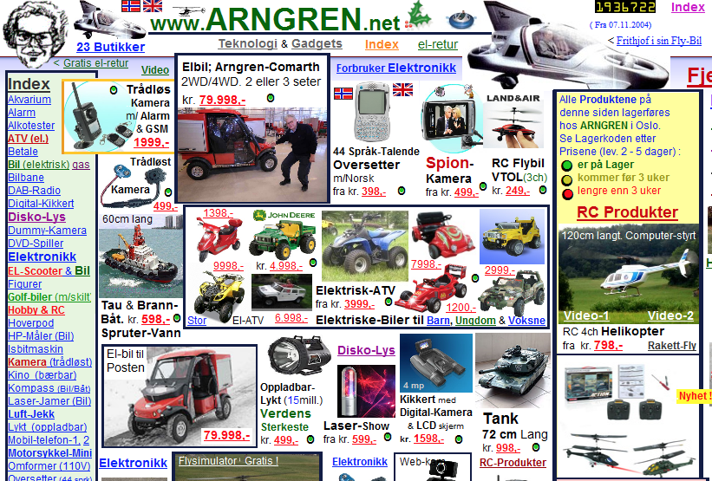

Slide 17
Rules To Follow:
Simple is Beautiful
User Friendly is Key
Utilize White Space
Fonts Matter
Be Consistent
Have a Good Color Scheme
Make Sure it is Not Cluttered

Slide 18
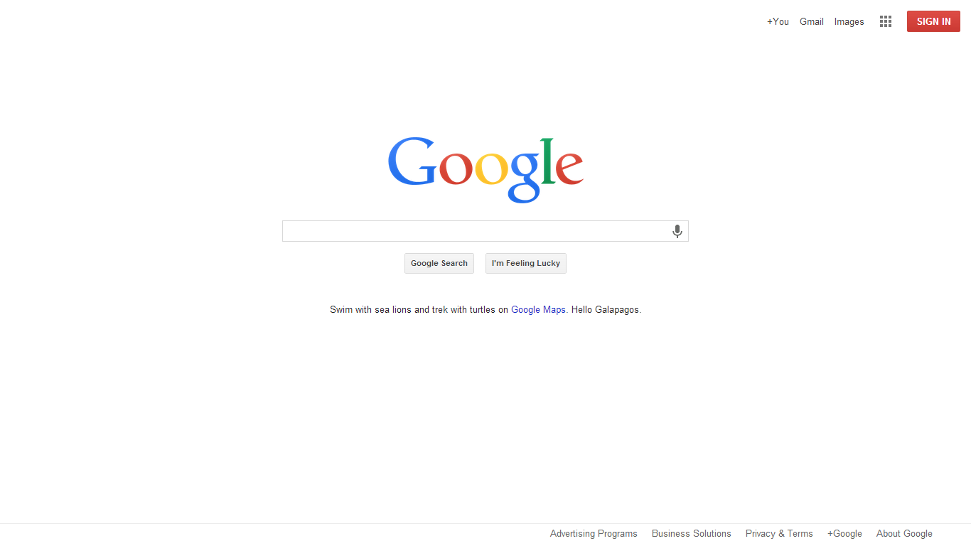


Slide 19
Rules To Follow:
Simple is Beautiful
User Friendly is Key
Utilize White Space
Fonts Matter
Be Consistent
Have a Good Color Scheme
Make Sure it is Not Cluttered

Slide 20
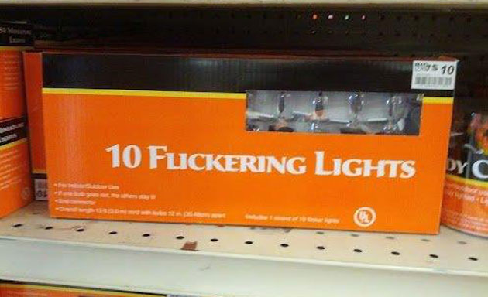
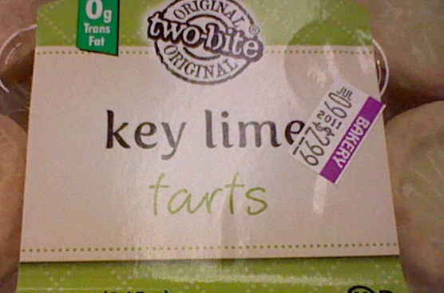


Slide 21
Rules To Follow:
Simple is Beautiful
User Friendly is Key
Utilize White Space
Fonts Matter
Be Consistent
Have a Good Color Scheme
Make Sure it is Not Cluttered

Slide 22


Slide 23
Rules To Follow:
Simple is Beautiful
User Friendly is Key
Utilize White Space
Fonts Matter
Be Consistent
Have a Good Color Scheme
Make Sure it is Not Cluttered

Slide 24



Slide 25
Rules To Follow:
Simple is Beautiful
User Friendly is Key
Utilize White Space
Fonts Matter
Be Consistent
Have a Good Color Scheme
Make Sure it is Not Cluttered

Slide 26
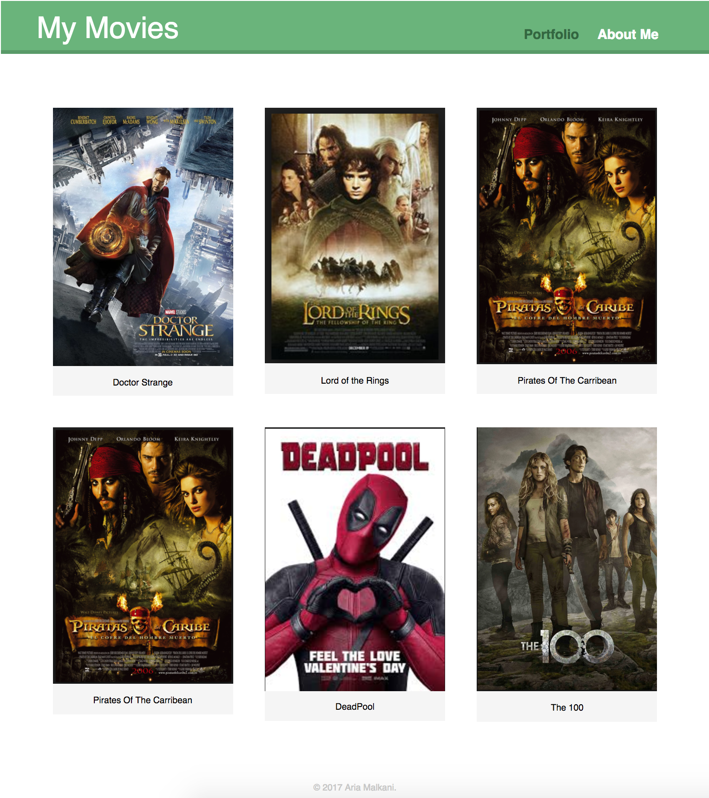
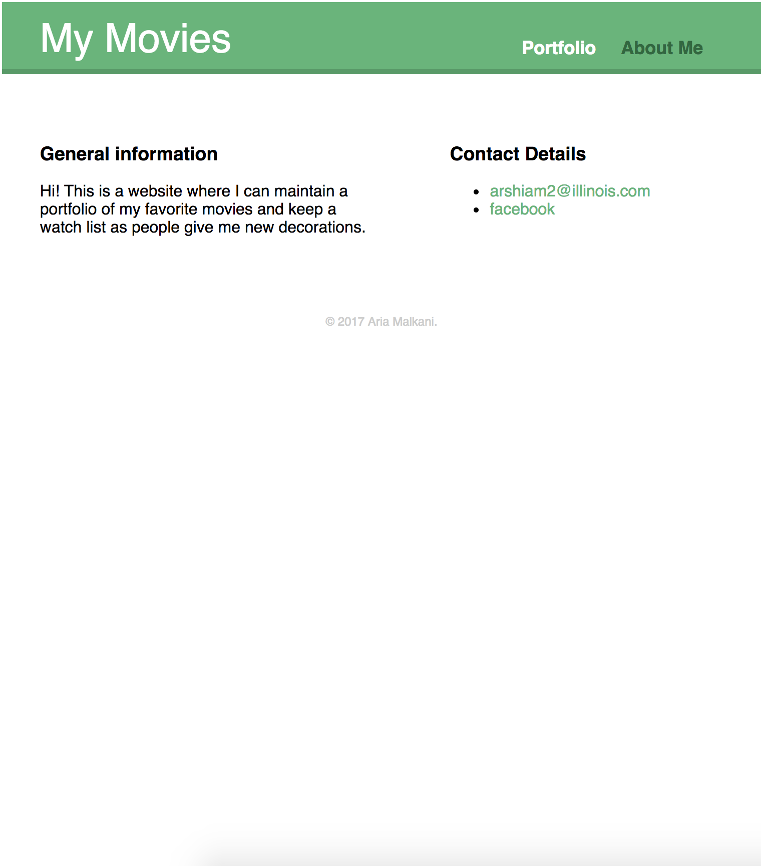
Movie Portfolio Project

